Slide 1


numerals
On the winning card two of the objects are ___

Slide 2

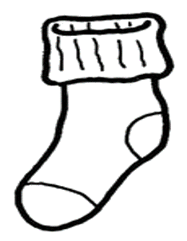
numerals
On the winning card two of the objects are ___

Slide 3
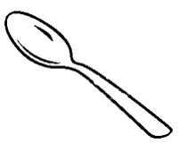

numerals
On the winning card two of the objects are ___

Slide 4
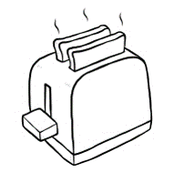
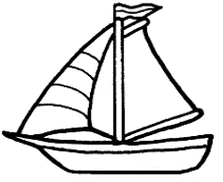
numerals
On the winning card three of the objects are ___

Slide 5

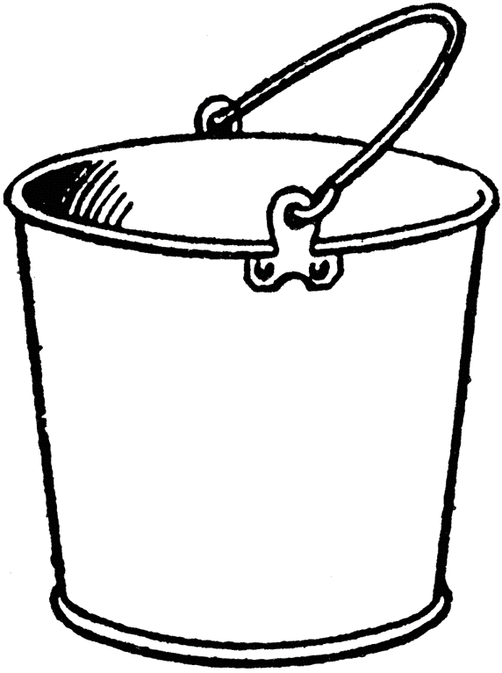
numerals
On the winning card three of the objects are ___

Slide 6
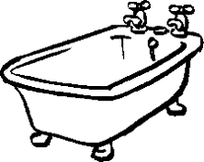

numerals
On the winning card three of the objects are ___

Slide 7


most
On the winning card most of the objects are ___

Slide 8


most
On the winning card most of the objects are ___

Slide 9


most
On the winning card most of the objects are ___

Slide 10
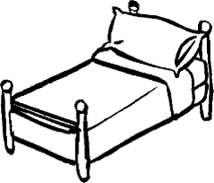
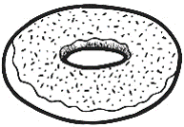
most
On the winning card most of the objects are ___

Slide 11

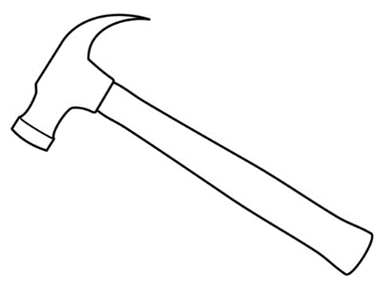
most
On the winning card most of the objects are ___

Slide 12
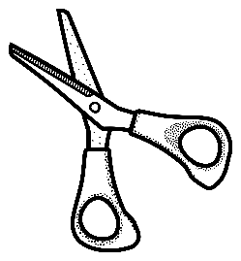

most
On the winning card most of the objects are ___

Slide 13
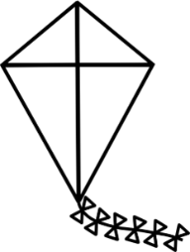
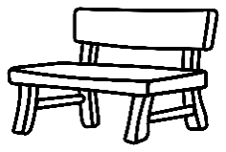
Ad hoc
On the winning card the objects in the top row are ___

Slide 14

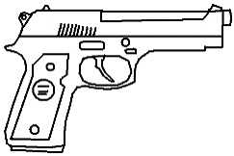
Ad hoc
On the winning card objects in the middle row are ___

Slide 15

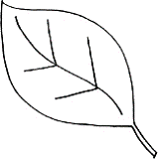
Ad hoc
On the winning card the objects in the bottom objects are ___

Slide 16

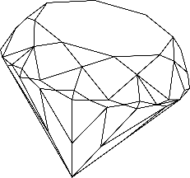
Ad hoc
On the winning card the objects in the top row are ___

Slide 17

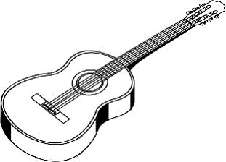
Ad hoc
On the winning card the objects in the middle row are ___

Slide 18

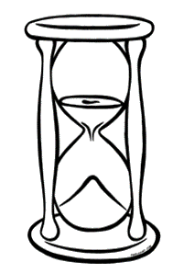
Ad hoc
On the winning card the objects in the bottom row are ___

Slide 20


Control: none
On the winning card none of the objects are ___

Slide 21
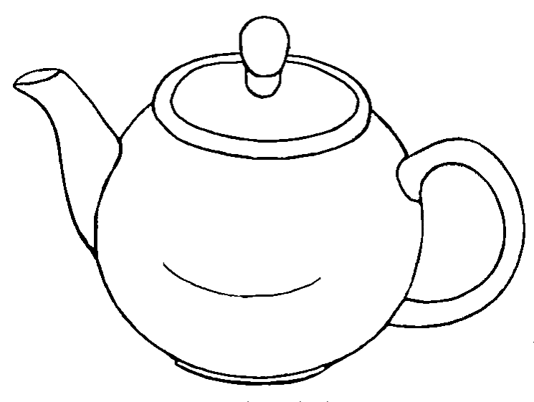

Control: none
On the winning card none of the objects are ___

Slide 22

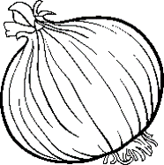
Control: none
On the winning card none of the objects are ___

Slide 23

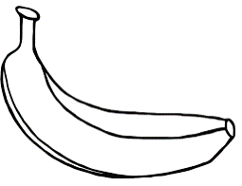
Control: none
On the winning card none of the objects are ___

Slide 24
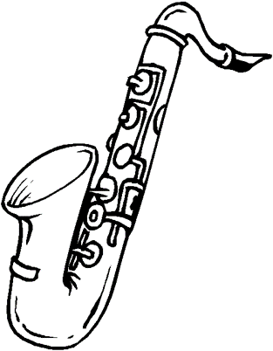
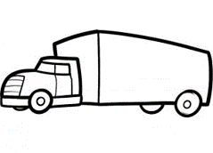
Control: none
On the winning card none of the objects are ___

Slide 25


Control: none
On the winning card none of the objects is ___

Slide 26


Control: none
On the winning card none of the objects are ___

Slide 27
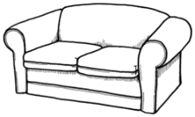
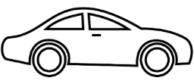
Control: none
On the winning card none of the objects are ___

Slide 28
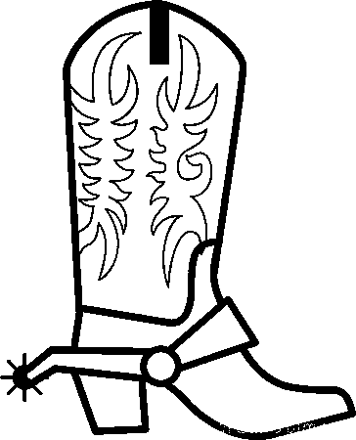
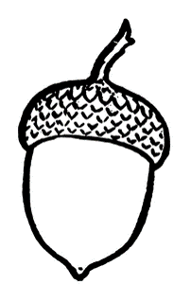
Control: none
On the winning card none of the objects are ___

Slide 29
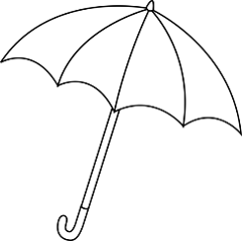

Control: all
On the winning card all of the objects are ___

Slide 30

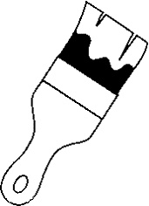
Control: all
On the winning card all of the objects are ___

Slide 31

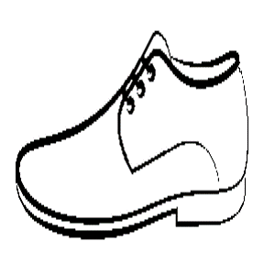
Control: all
On the winning card all of the objects are ___

Slide 32


Control: all
On the winning card all of the objects are ___

Slide 33
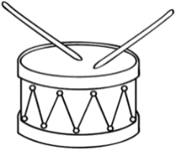
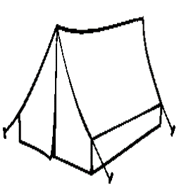
Control: all
On the winning card all of the objects are ___

Slide 34
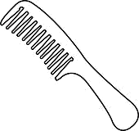
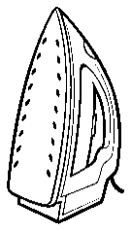
Control: all
On the winning card all of the objects are ___

Slide 35


Control: all
On the winning card all of the objects are ___

Slide 36


Control: all
On the winning card all of the objects are ___

Slide 37
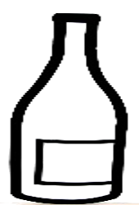
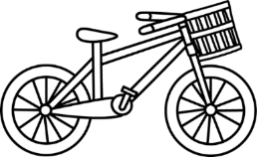
Control: all
On the winning card all of the objects are ___

Slide 38


EXAMPLE
EXAMPLE: On the winning card none of the objects are hats

Slide 39
EXAMPLE
EXAMPLE: On the winning card none of the objects are hats

Slide 40
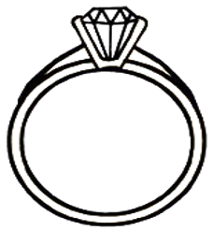
On the winning card the top object is ___

Slide 41

On the winning card the objects in the top row are red or ___

Slide 42
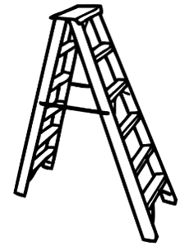

On the winning card the top object is ___

Slide 43

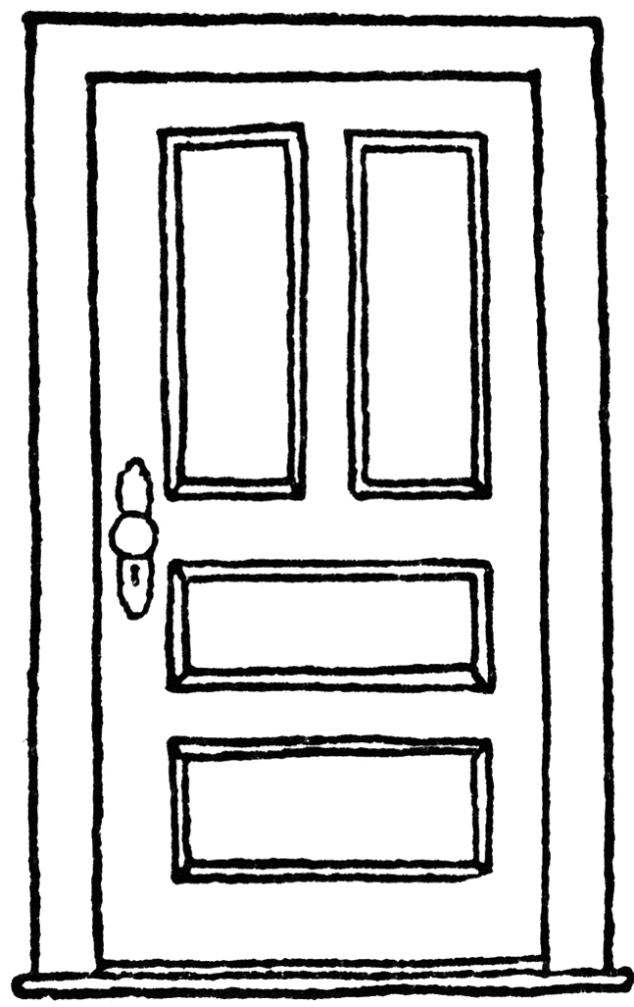

On the winning card the top object is ___

Slide 44

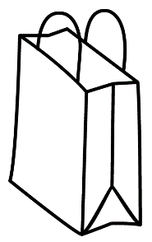
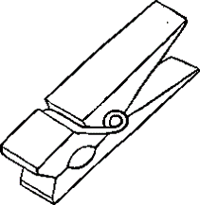


SCARTI

Slide 45


